Slide 1
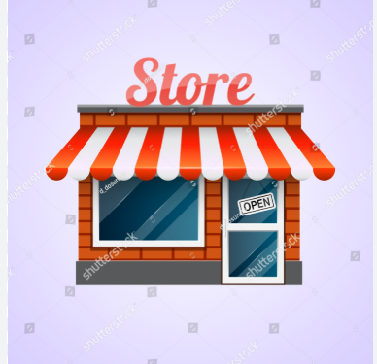
Store background
A retail store chain tracks daily sales transaction ,including order details ,customers info product categories ,order times and orders status.
The business wants to optimize operations improved customer experience and increase profitability using data-driven decisions.

Slide 2


Problem statement
Problem
This store doesn’t have a clear idea about
Which products sell the most .
Customer preference
Which items bring in the most profit and where things are going wrong in delivery or operations
Solutions
They need proper reports and simple insight to understand their sales customer and product performance better
Because of this they are missing chances to earn more ,losing customer s and making poor business decisions

Slide 3
BUSINESS PROBLEM ?
Q1:- what are the top 5 most selling products by quantity ?
Q2:- which product are most frequency cancelled ?
Q 3:- what time of day has the highest number of purchases ?
Q4:- who are the top 5 highest spending customers ?
Q5 :- which products categories generate the highest revenue?
Q6:- what is return /cancellation rate per product category ?
Q7 :-what is the most preferred payment mode ?
Q8:- how does age group affect purchasing behavior ?
Q9:- what's the sales trends ?
Q10:-- are certain gender busing more specific product categories ?

